Slide 1
>Time Use Data:
A window into society
>Dr. Chunjiang Li & Prof. Michael Widener
>January 28th, 2025
>_

Slide 2

How do you spend your time?
The answer to this question can help us understand SO MANY THINGS about society.
Time use survey is used across the social sciences, from urban planning to economics to sociology.
At its core, time use survey usually asks:
What do you do?
When did you do it?
Who did you do it with?
Where did you do it?
How did you do it?
What was the sequence of the things you did?

Slide 3
Think about it 🤔 : how to collect people’s time use?
If you want to do a time use survey to collect information regarding how much time respondents spent on various activities in the day before survey day (yesterday), what questions would you ask?

Slide 4
Think about it 🤔 : how to collect people’s time use?
“Individual-based”
“Episode-based”
How much time did you spend on sleeping?
Where were you when you were sleeping?
Who were you with when you were sleeping?
Think about what you have done yesterday. Let’s start from the first activity at 4:00 in the morning:
What were you doing at 4:00am?
Starting at 4:00 am, how long did this activity last?
Where were you?
Who were you with?
How much time did you spend on … (e.g., working, traveling, socializing)

Slide 5
Think about it 🤔 : how to collect people’s time use?
“Individual-based”
“Episode-based”
How much time did you spend on sleeping?
Where were you when you were sleeping?
Who were you with when you were sleeping?
Think about what you have done yesterday. Let’s start from the first activity at 4:00 in the morning:
What were you doing at 7:35am?
Starting at 7:35am, how long did this activity last?
Where were you?
Who were you with?
How much time did you spend on … (e.g., working, traveling, socializing)

Slide 6
We choose Episode-based questions. But why?
“Individual-based”
“Episode-based”
How much time did you spend on sleeping?
Where were you when you were sleeping?
Who were you with when you were sleeping?
Think about what you have done yesterday. Let’s start from the first activity at 4:00 in the morning:
What were you doing at 7:35am?
Starting at 7:35am, how long did this activity last?
Where were you?
Who were you with?
How much time did you spend on … (e.g., working, traveling, socializing)
https://www23.statcan.gc.ca/imdb/p3Instr.pl?Function=assembleInstr&lang=en&Item_Id=1395477

Slide 7
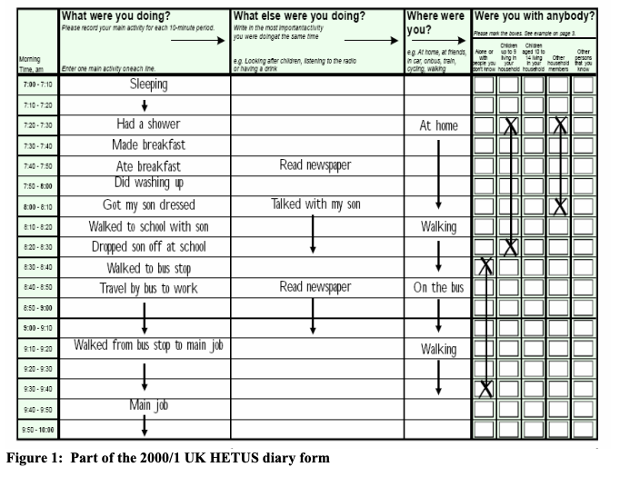
Pros:
More intuitive to respondents (instead of researchers/ investigators!)
Easily recall
International comparison
Continuous 24-hour period
Cons:
Hard to answer
Difficulty in coding
Hard to be digitalized
https://www.timeuse.org/sites/ctur/files/public/ctur_report/4486/timeusesurveysandwellbein_tcm77-232153.pdf

Slide 8
Using time use data in GGR 274
You will be working with the time use data from Statistics Canada in this course.
Canada does a national time use survey every five years
You can access these datasets at chass.utoronto.ca going back to 1986
Most recent: 2022
Statistics Canada describes the survey in more detail here:
https://www23.statcan.gc.ca/imdb/p2SV.pl?Function=getSurvey&Id=1268587

Slide 9
So what data does Statistics Canada Collect?
Use the episode-based method (but in a digital form)
Belong to General Social Survey (GSS) every 5 years
Target population for the survey is non-institutionalized persons 15 years of age or older, living in the 10 provinces across Canada
Sample size of approximately 20,000 respondents
weights computed to help make responses nationally representative
Overview of 2019 survey from Stats Can: https://www150.statcan.gc.ca/n1/en/pub/89f0115x/89f0115x2019001-eng.pdf?st=1YxqIEvL

Slide 10
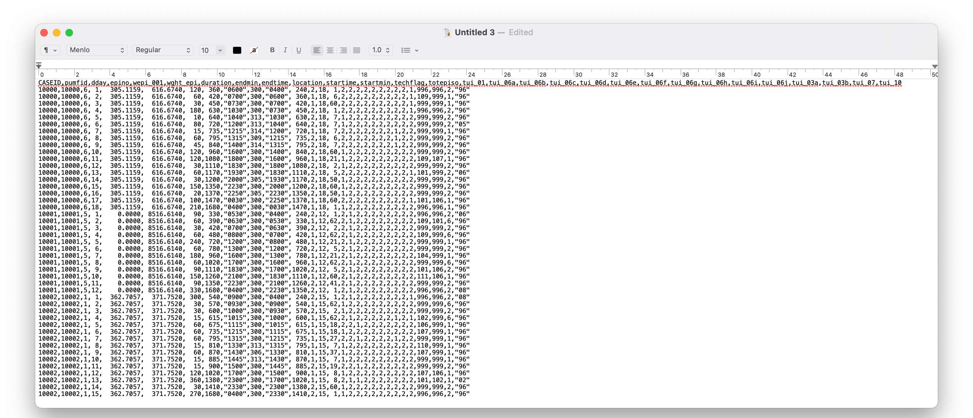
So what data does Statistics Canada Collect?
Episode File:
One guy with 18 episodes (activities).

Slide 11
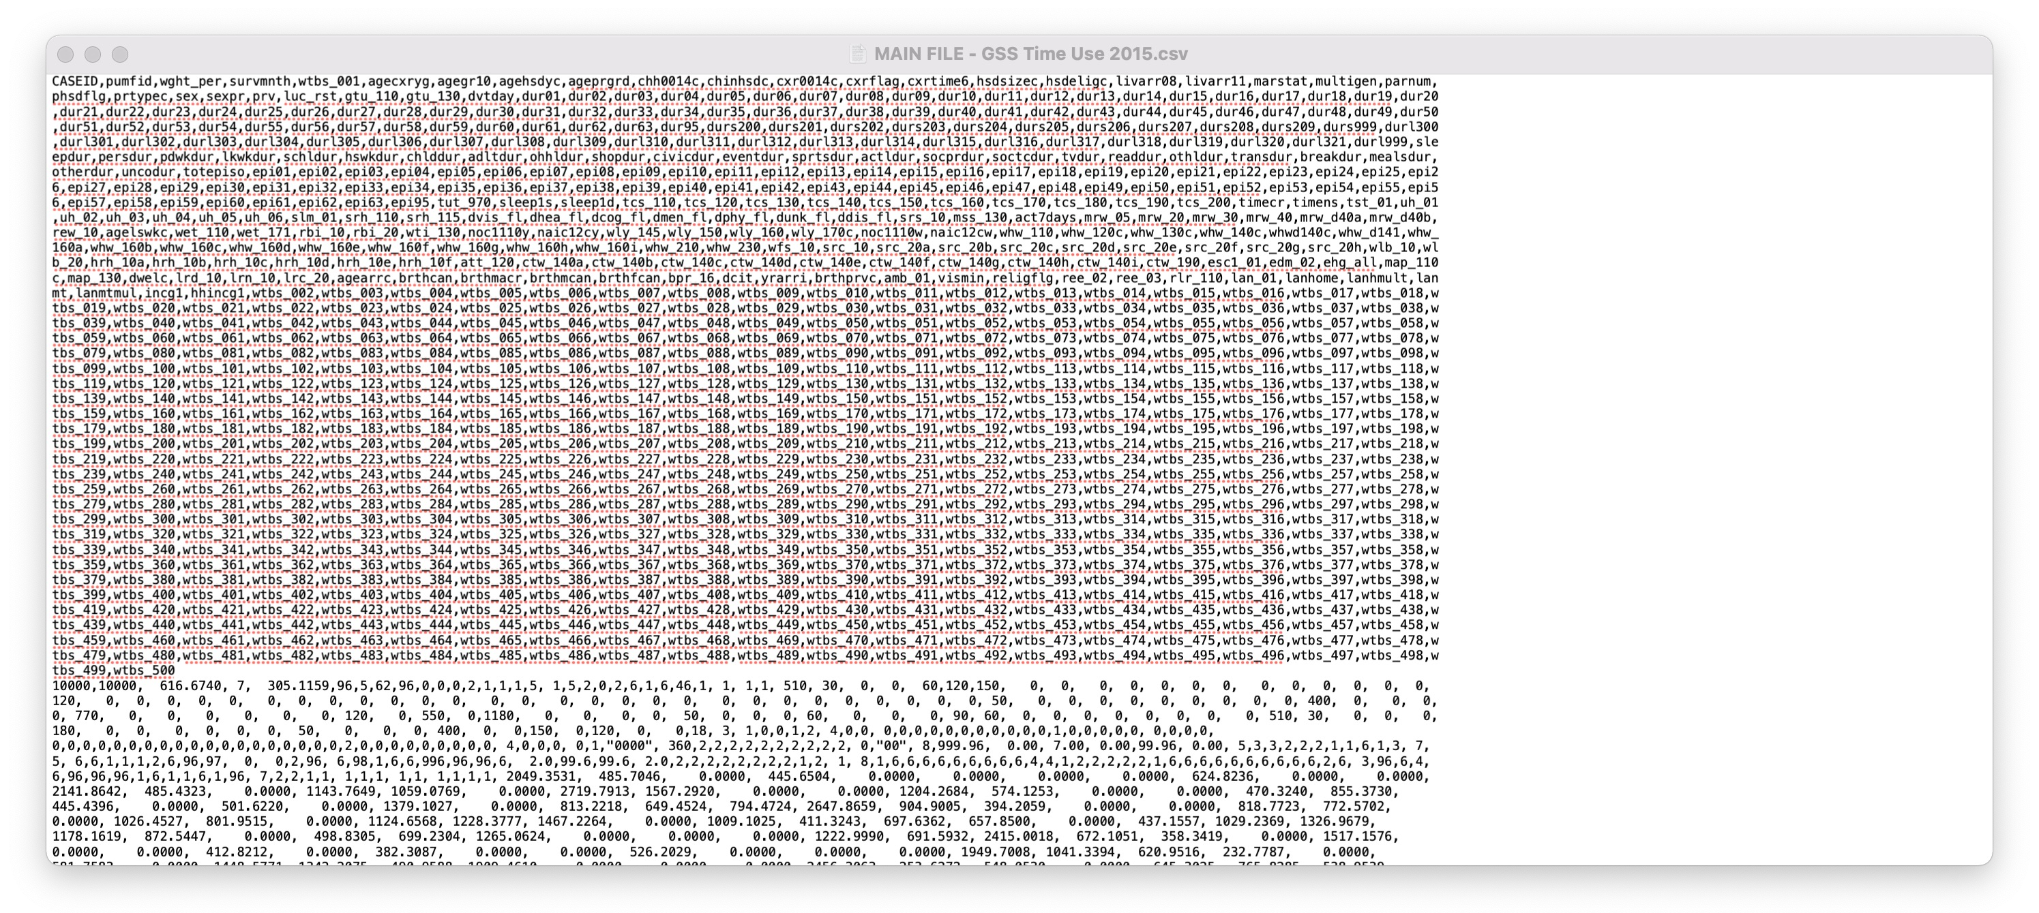
So what data does Statistics Canada Collect?
Main (Individual) File (aggregated from episode file):
The guy with 18 activities but aggregated in duration

Slide 12
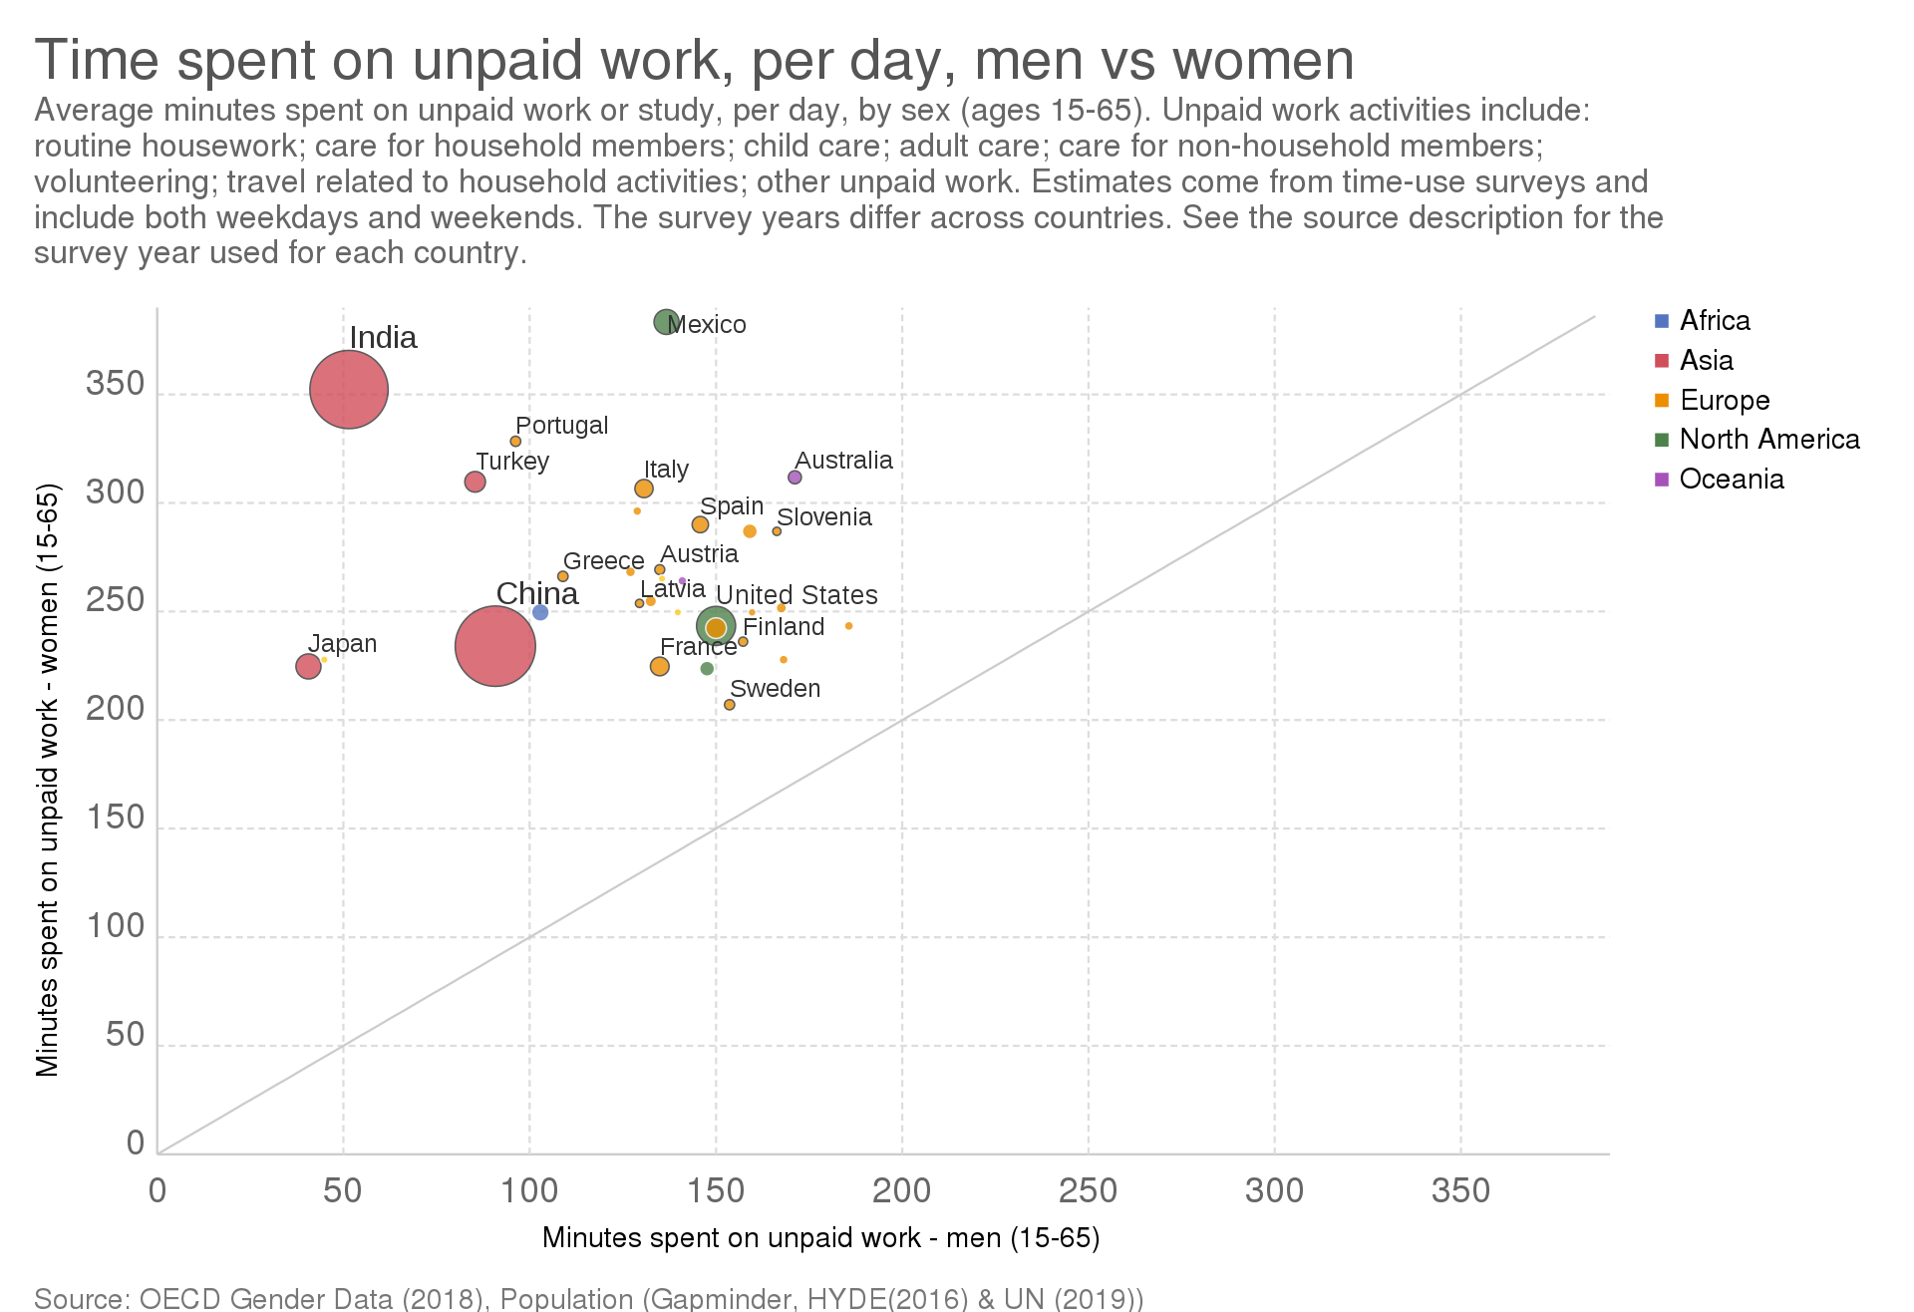
Exploring time use data
The power of these data comes from our ability to explore aggregate trends, as well as individual patterns
At the aggregate level, we can examine type of time use (let’s say unpaid work) and split our dataset using another.
World Bank Blog on the importance of time use data:
https://blogs.worldbank.org/opendata/why-time-use-data-matters-gender-equality-and-why-it-s-hard-find

Slide 13

Exploring time use data
food chores
transport
chores/childcare
food shopping
At the individual level, we can explore sequences of activities to understand why certain events happen before/after others
We can also look at how connected individuals coordinate activities at a household level
Mother
Father
work
7 days time-use sequences in a household

Slide 14

Questions to think about…
What type of information is found in Episode File?
When do we want to use this data?
What type of information is found in Main File?
How can we link episode file and main file?
What are some limitations to using time use data?
What CAN’T it tell us?

